Slide 1

LTI IS EASY!
PRESENTATION BY:
PETER HANLEY, TEMPLE UNIVERSITY
Notes:
v

Slide 2
ABOUT TEMPLE U
PUBLIC, 4-YEAR RESEARCH UNIVERSITY WITH ~40,000 STUDENTS
~6000 COURSES/SEMESTER , ~90% use LMS
BB LEARN ➜ CANVAS IN ONE YEAR (AS OF JUNE 1st)
43 ACCOUNT-LEVEL EXTERNAL TOOLS (3 & COUNTING HOMEGROWN)
ABOUT ME
25 YEARS: WEB DEV ➜ INSTRUCTIONAL TECH ➜ LMS ADMIN & DEVELOPER
LTI TOOL PROVIDERS IN PHP & PYTHON (IN VARIOUS RELEASE STAGES)
BAD HABIT: “THAT SOUNDS EASY!”

Slide 3
ABOUT YOU…?*
YOU WORK WITH CANVAS…?
YOU HAVE SOME CODING/SCRIPTING UNDER YOUR BELT…?
YOU’VE HAD AN IDEA FOR AN AWESOME TOOL …?
BUT SOMETHING DIDN’T WORK…?
Notes:
LTI can be frustrating to get started with, but like anything else it's much easier if you begin with the right tools.
Come to learn about the software ecosystem that will help transform an idea into a working external tool.

Slide 4
“Sample code provided”
https://github.com/hanleybrand/LTI-is-easy/
ALSO NOTES AND LINKS
HOPEFULLY EVERYTHING I MENTION WILL BE THERE
Notes:
Sample code provided.

Slide 5
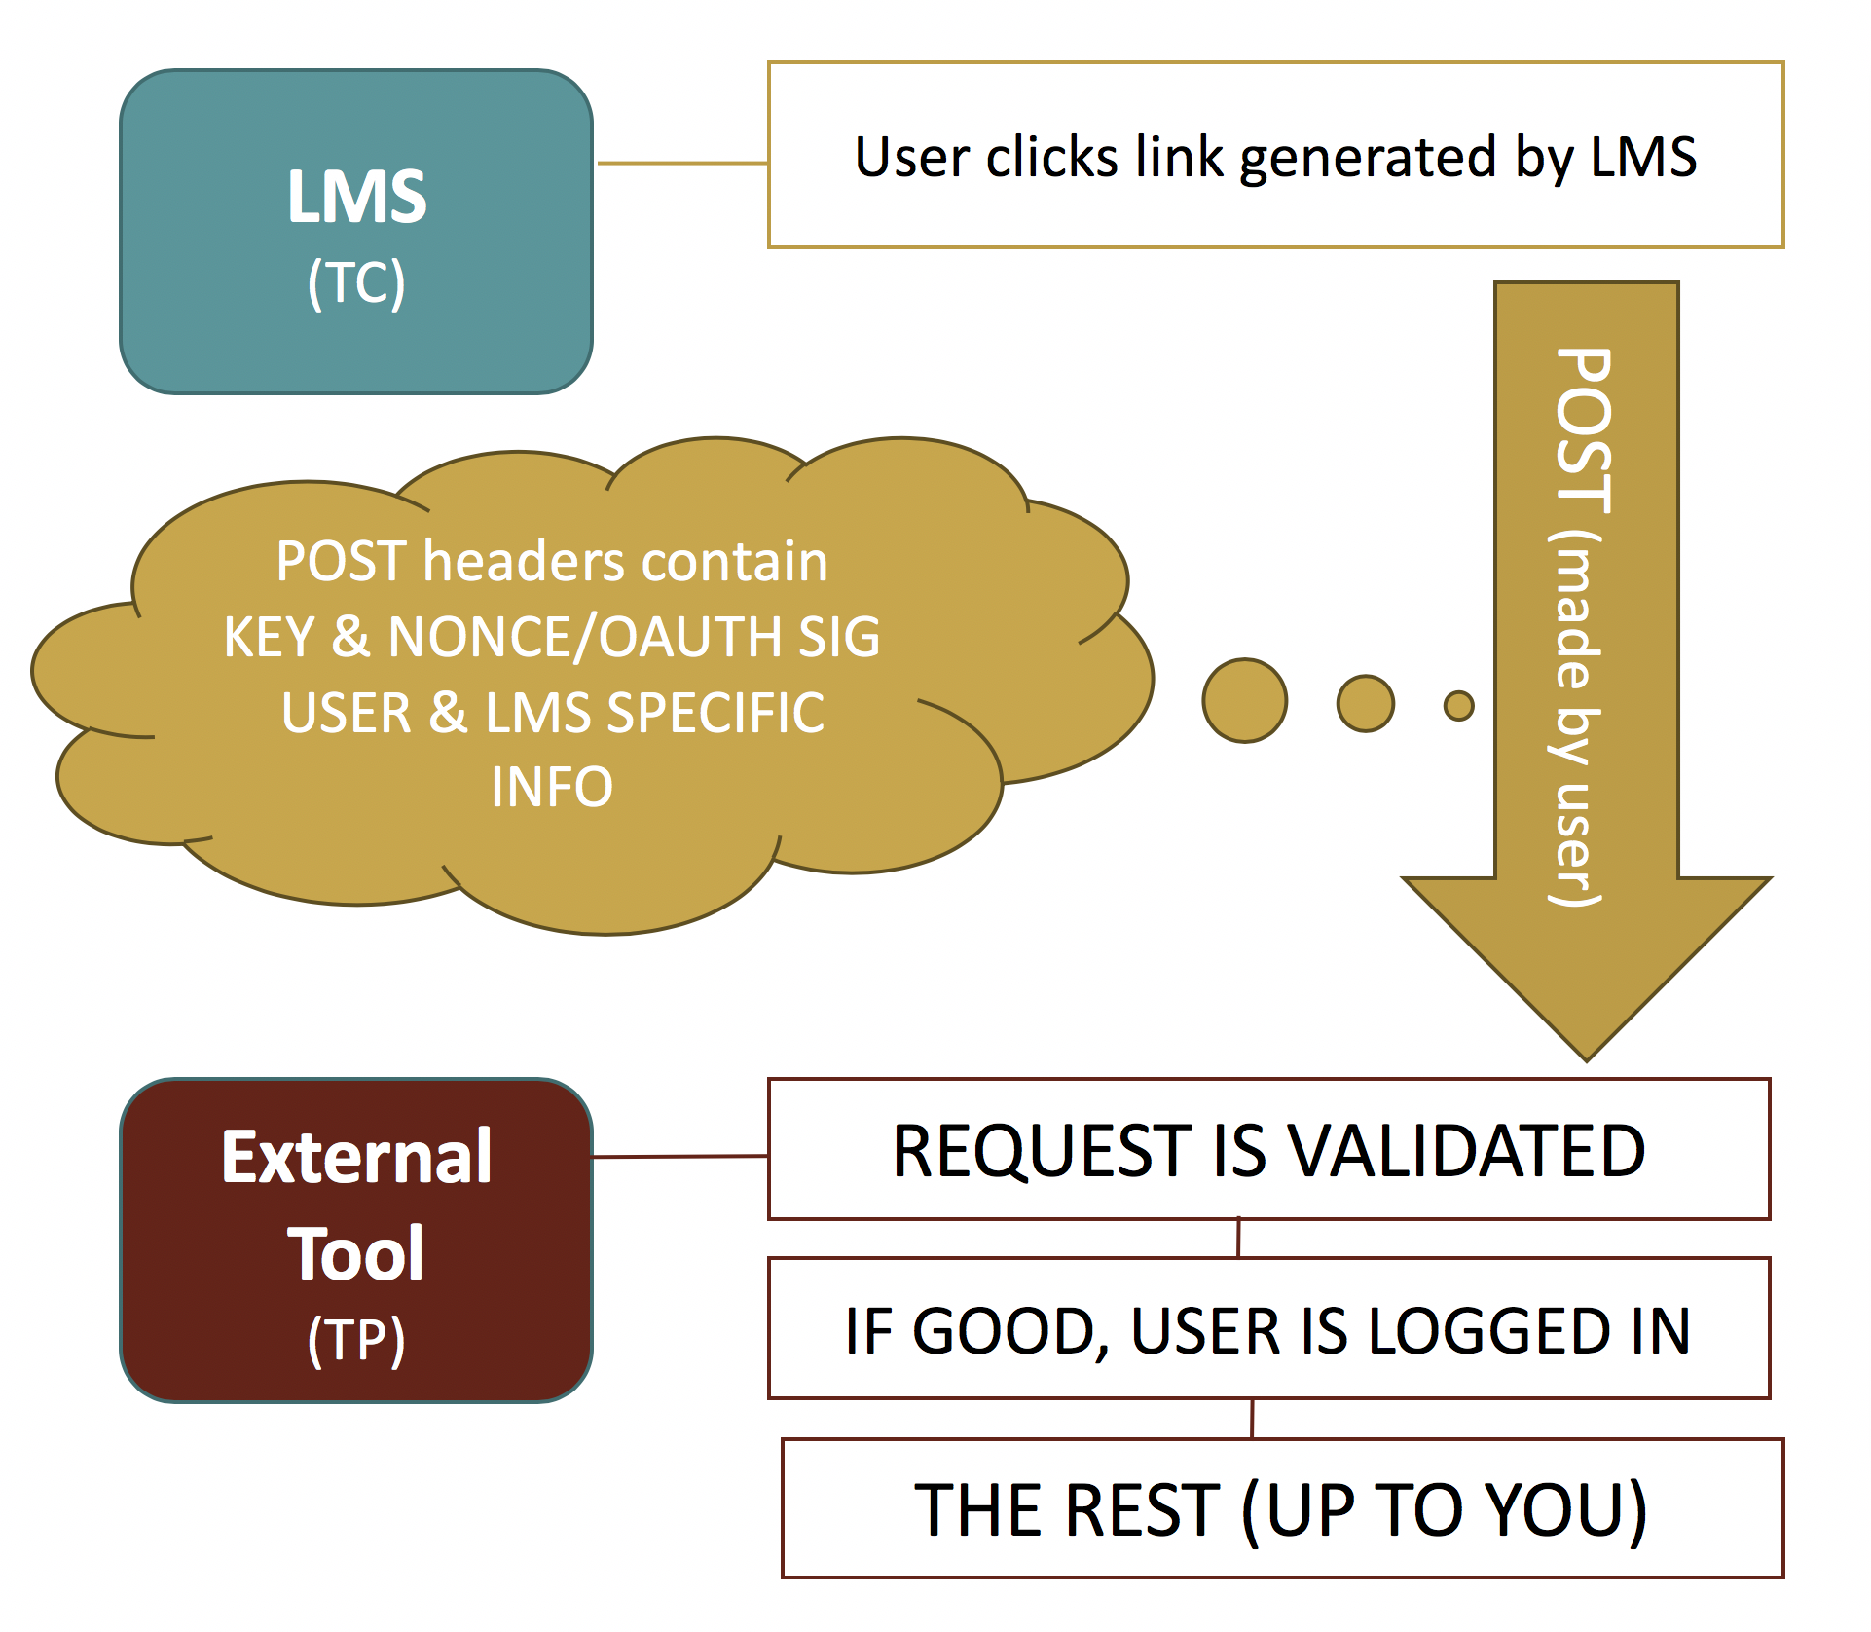
LTI 1.0 OVERVIEW
VERY BASIC:
THE CONSUMER (TC) sends a user to another web app (AKA THE PROVIDER, AKA TP) with:
USER INFO (name, email, etc.)
LMS STUFF (roles, context info)
THE FLOW:
TC CREATES POST
BROWSER DOES THE POST
TP DOES THE REST

Slide 6
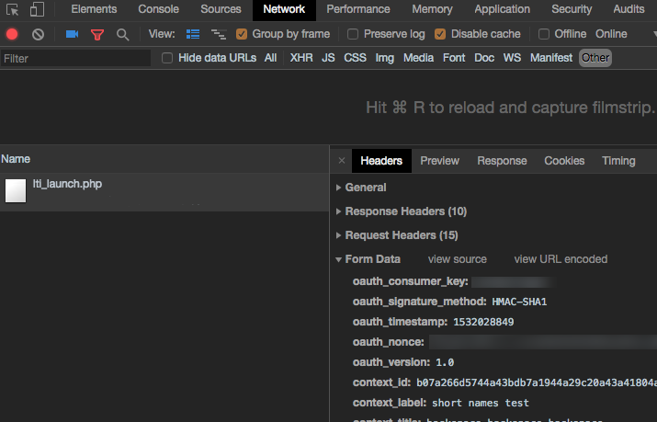
DEVELOPER TOOLS
(THE-IN-YOUR-BROWSER-KIND)
AVAILABLE IN EVERY BROWSER
FREE, ALREADY INSTALLED
THE NETWORK PANEL IS YOUR BEST FRIEND WHEN YOUR LTI LAUNCH DOESN’T WORK BECAUSE SOMETHING ISN’T RIGHT
THE ONLY HARD PART IS SIDE-BY-SIDE COMPARING YOUR FORM DATA WITH THE IMS SPECS
Notes:
Foliotek LTI Tester - http://foliotek.github.io/LTI-Tester/

Slide 7
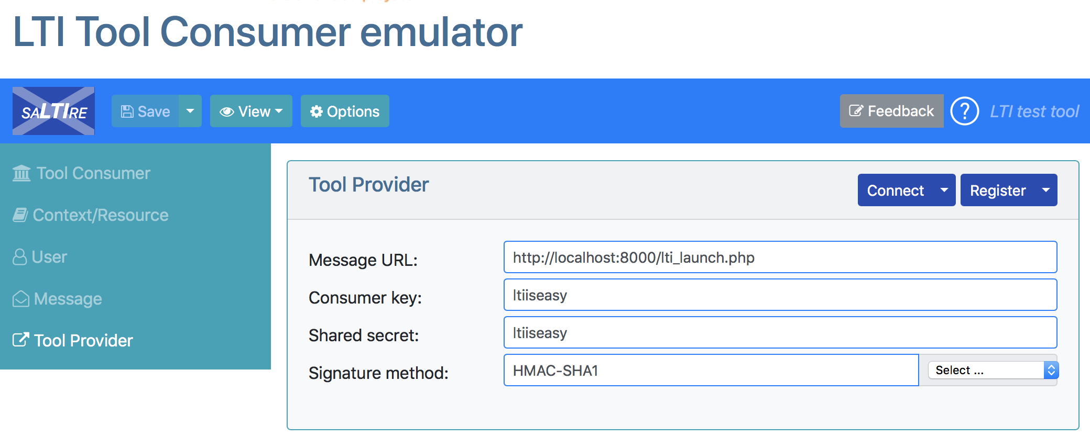
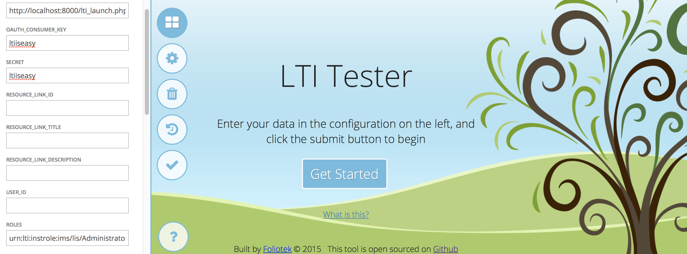
FAKE IT THEN MAKE IT
USE A TC EMULATOR TO MAKE SURE YOUR LAUNCH IS HANDLED CORRECTLY IN YOUR TP
USE DEV TOOLS TO INSPECT YOUR POST DATA
…BUT WHAT IF IT STILL ISN’T WORKING?
Notes:
urn:lti:instrole:ims/lis/Administrator,urn:lti:instrole:ims/lis/Instructor,urn:lti:instrole:ims/lis/Student,urn:lti:role:ims/lis/Instructor,urn:lti:sysrole:ims/lis/User

Slide 8
SERVER SIDE SNOOPING
The literal ”other side of the fence” (except it’s not a literal fence)
OFTEN DIFFICULT TO SEE WHAT’S GOING ON USING LOGS
THOSE ERROR MESSAGES THOUGH
MAYBE [print/ println/echo/console]?
”DEBUG BAR” STYLE TOOLS ARE LIKE DEV TOOLS BUT ON YOUR SERVER
INSPECT THE GET/POST ON THE SERVER
PROFILE CODE & DATABASE PERFORMANCE
FIND WEIRDNESS

Slide 9
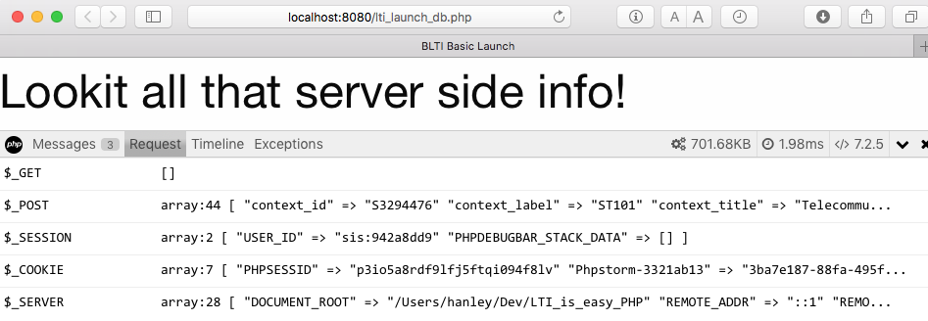
SERVER SIDE SNOOPING

Slide 10
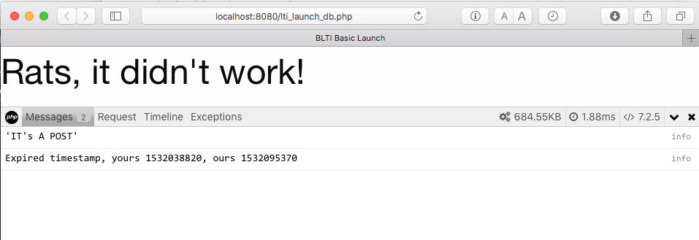
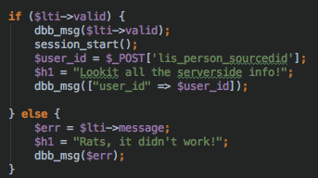
SERVER SIDE SNOOPING

Slide 11
ONCE CONNECTED…
LTI 1.0: UNLESS YOU INTERVENE, THE TC’S PART IS DONE
LTI 1.1: OUTCOMES (TP CAN POST BACK A GRADE, ETC)
LTI 1.0 + CANVAS API: ALL KINDS OF FUN
LTI 1.3: COMING SOON:
NEW SECURITY MODEL
DEEP LINKING
ENHANCED OUTCOMES
PROVISIONING SERVICES (e.g. CLASS LISTS)

Slide 12
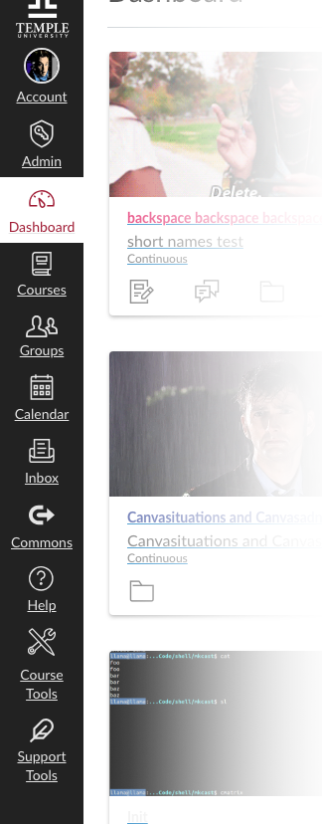
SHOW & TELL: COURSE TOOLS
TEMPLE FACULTY MANAGE THEIR OWN COURSE CREATION/ENROLLMENT
COURSE TOOLS IS THE MIDDLEWARE
USES LTI 1.0 FOR AUTHENTICATION & CANVAS REST API
CREATE/COMBINE COURSES & SECTIONS FROM SIS DATA
ALLOWS AD HOC CREATION OF SHELLS FOR FACULTY & STAFF
SUPPORT TOOLS IS SIMILAR, BUT FOR SUPPORT STAFF

Slide 13
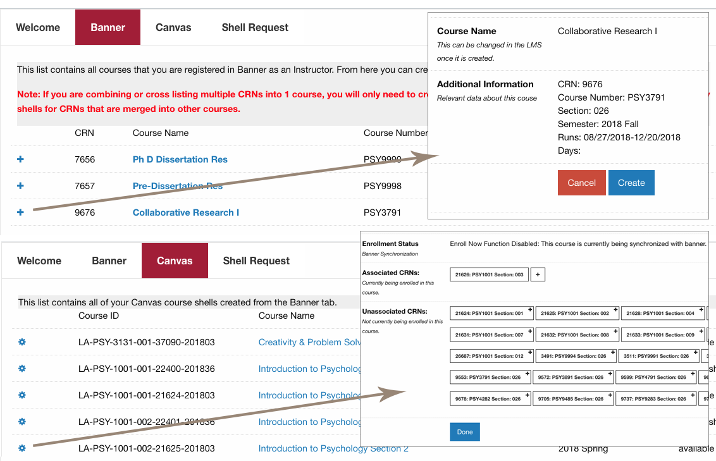

Slide 14
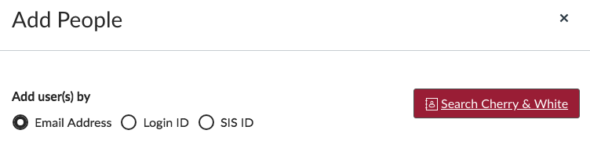
SHOW & TELL: SEARCH C&W
CUSTOM ENROLLMENTS WERE AN ISSUE
USERNAMES LIKE TUZ98402
EMAIL ALIASES AREN’T STABLE (e.g. I CAN CHANGE TO PETER|PETER.HANLEY|PETER.M)
ENROLLING VIA EMAIL , LOGIN OR SIS ID WAS NO GO
COMPLAINTS WERE ROLLING IN

Slide 15
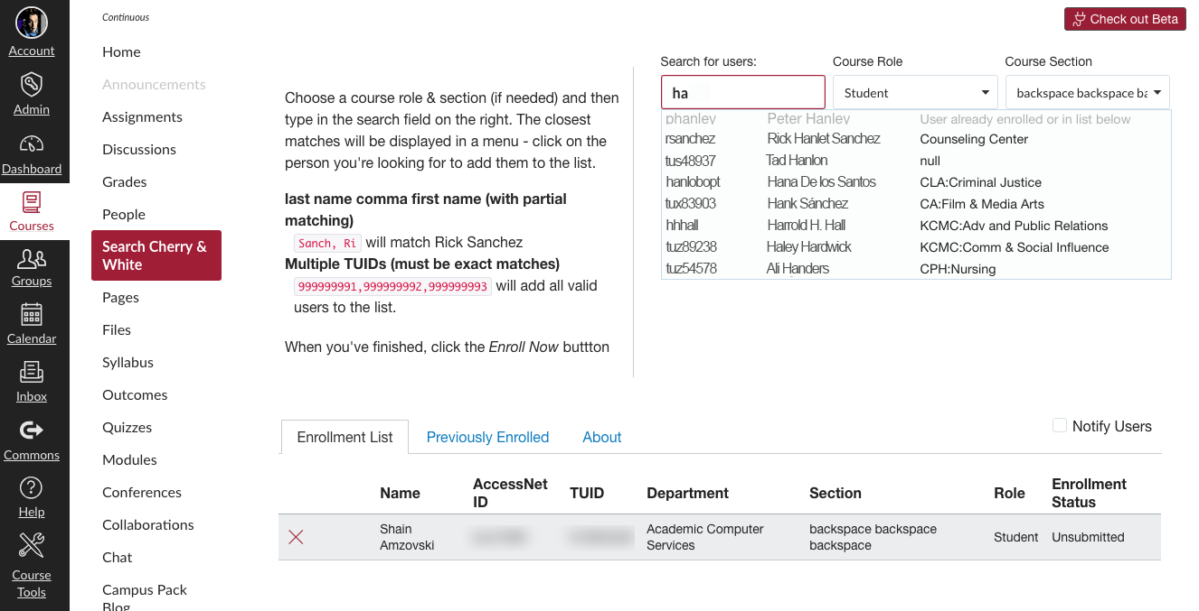

Slide 16
Both examples use
LTI 1.0 FOR AUTH FROM CANVAS
PHP FOR THE TP
CANVASPEST -> CANVAS REST API
SQL SERVER -> DIRECTORY/SIS DATA
JAVASCRIPT/AJAX
Search Cherry & White uses Canvas CSS which was a fun additional bit
We can’t stand not being able to change the Canvas UI apparently

